Slide 1
UNIT3-S3 LIGHT SOURCE MATERIALS

Slide 2
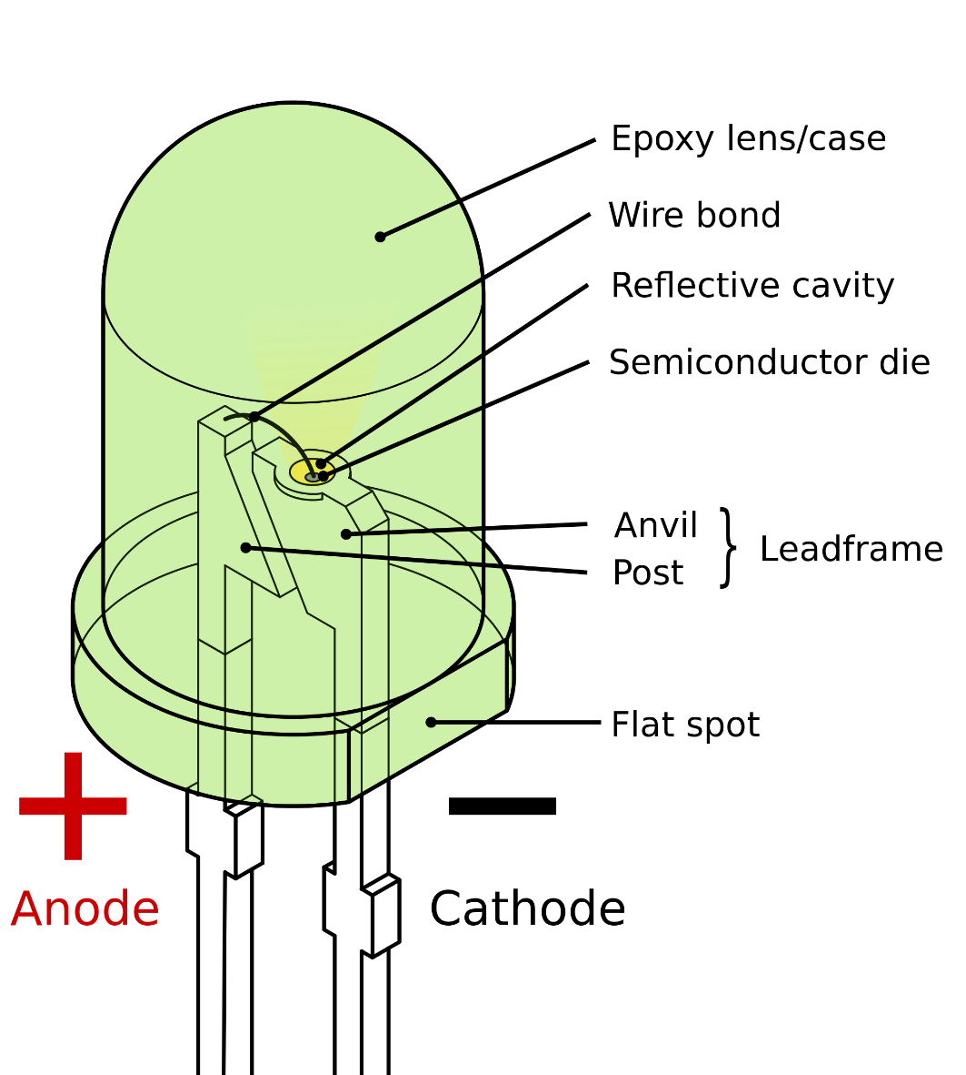
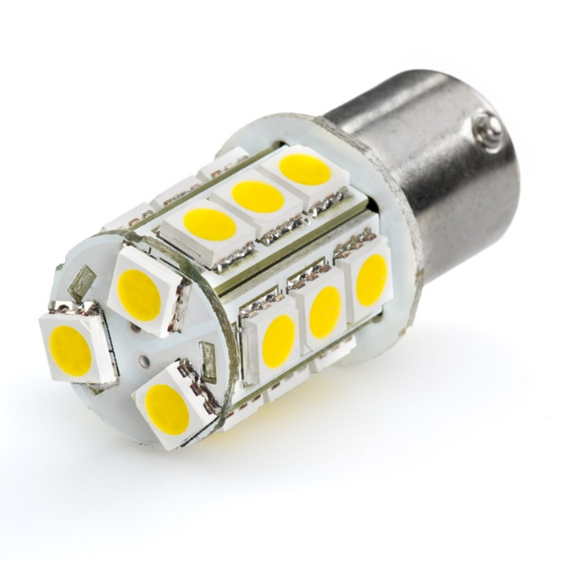
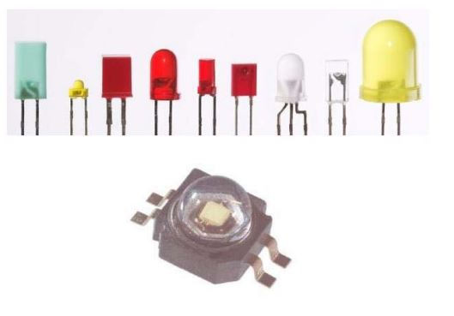

Slide 3
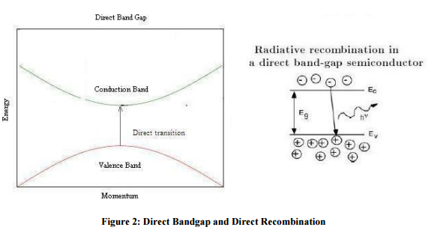
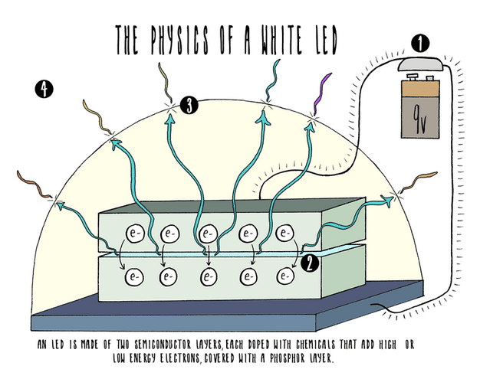

Slide 4
Materials
Aluminum gallium arsenide
Aluminum gallium indium phosphide
Aluminum gallium nitride
Aluminum nitride
Gallium arsenide
Gallium arsenide phosphide
Gallium phosphide
Indium gallium nitride
Indium gallium phosphide

Slide 5
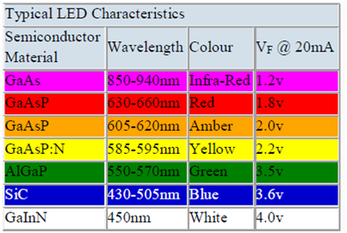
LEDs can be made up from group III and V elements from the periodic table.
III-Nitride semiconductors(AlN, InN, GaN): Can create LEDs to cover the ultraviolet to the entire visible spectrum.

Slide 6
GALLIUM ARSENIDE (GaAs)
This is a direct bandgap semiconductor with £g = 1.443 eV suitable p-n junctions may be made by diffusing zinc into crystals of n-type GaAs .The resulting radiation arises from band-to-band transitions, however, and is consequently subject to heavy reabsorption; this reduces the device efficiency and shifts the peak emission wavelength to about 870 nm.
More efficient diodes may be made by using silicon as a dopant, where, depending on the growth conditions, either p or n material is obtained. Complex acceptor levels are also formed about 0.1 eV above the valance band. Transitions between these and the conduction band give rise to radiation with a peak emission wavelength of about 1000 nm which is not subject to reabsorption.

Slide 7
GALLIUM PHOSPHIDE (GaP)
This is an indirect bandgap semiconductor with £g = 2.26 eV (WAVELENGTH = 549 nm) and hence band- to-band transitions are rare. Group V elements such as N and Bi may be used as dopants to assist radiative transitions. These replace the phosphorus atoms and form recombination centers called isoelectronic traps. In the case of nitrogen the effective trap depth below the conduction band is small (8 meV) and the subsequent radiation has a peak wavelength only slightly less than \. Using increased levels of nitrogen doping and also doping with zinc and oxygen simultaneously give rise to deeper traps and consequently higher emission wavelengths.
GALLIUM ARSENIDE PHOSPHIDE (GaAsP)
The energy gap of this ternary alloy depends on the value of .v and furthermore it changes from being a direct bandgap when ,v< 0.45 to an indirect bandgap when ,v > 0.45. Using diodes with .v = 0.4 results in red emission (Fig. 4. 16). The indirect bandgap material can also be used in conjunction with the same radiative assisting dopants as used in GaP.

Slide 8
GALLIUM ALUMINIUM ARSENIDE (Ga x AI As)
Highly efficient red- and near-infrared-emitting LEDs can be made from this material. If a heterojunction is formed between n-type Ga(UAl<)7 As and p-type Ga<UlAl(U As, electrons injected from the n surface layer into the p material recombine radiatively via acceptor levels and result in radiation of 650 nm wavelength. This can pass through the surface layer with
little attenuation because of the relative large bandgap of the latter.
III-V NITRIDES (E.G. GAN AND AIN)
These materials have energy gaps that correspond to emission wavelengths from green all the way into the ultraviolet. A number of problems frustrated the early development of these materials; for example, until recently there was a lack of suitable substrate materials with matching lattice constants and thermal expansion coefficients. It also proved difficult to dope the materials p-type. It was not until the early 1980s that these problems were overcome, when it was found that the deposition of buffer layers allowed growth on readily available substrates such as sapphire and silicon carbide. In addition new growth and irradiation techniques have enabled p-type layers to be fabricated.
INDIUM GALLIUM ARSENIDE
High brightness LEDs are now commercially available based on InGaAs, although the structures (e.g. 'double heterostructures are somewhat more complicated than those discussed so far. By increasing the indium content the emission wavelength increases, and radiation in the green can also be obtained with reasonably high efficiency.

